Slide 1

Project-2
Lan,Patrick,nick,sadi, Teresa

Slide 2
Objective: How did Covid changed the year of 2020?
A. Covid-19 Cases in 2020
B. Flights in 2020
C. Stock market
D. …..

Slide 3
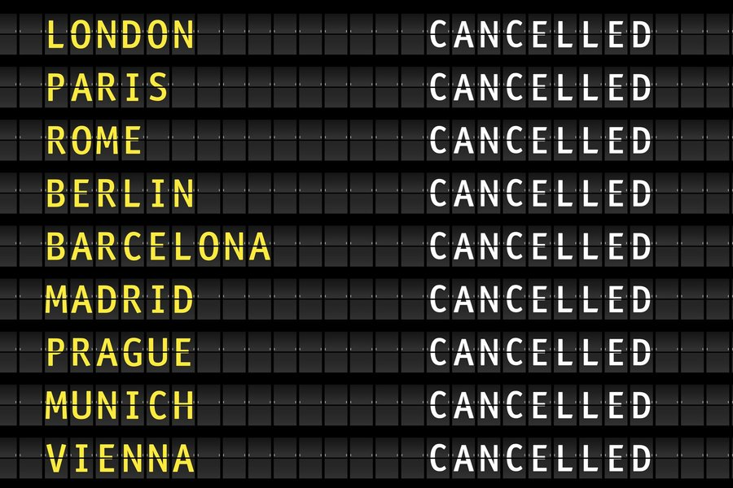

Covid-19 cases and flights in 2020

Slide 4
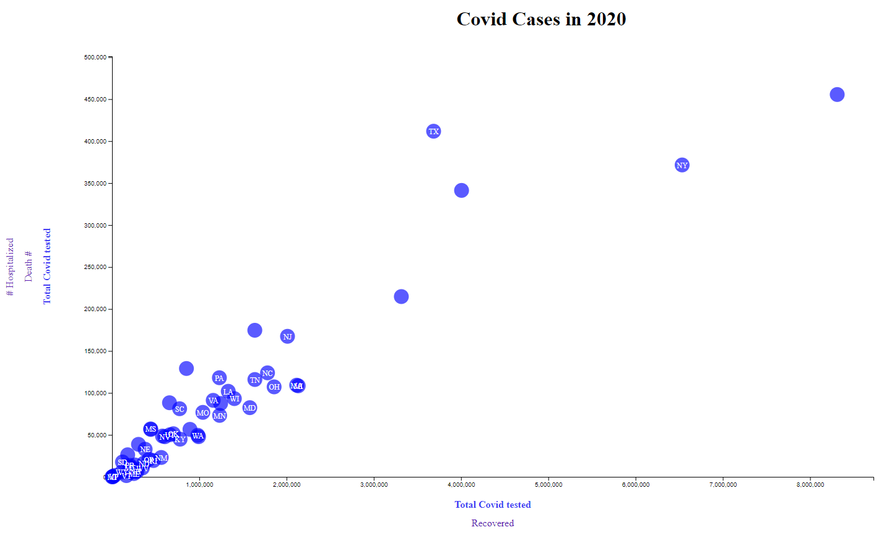
Covid cases in United States
Top 5 states:
- CA
- NY
- TX
- FL
- IL

Slide 5
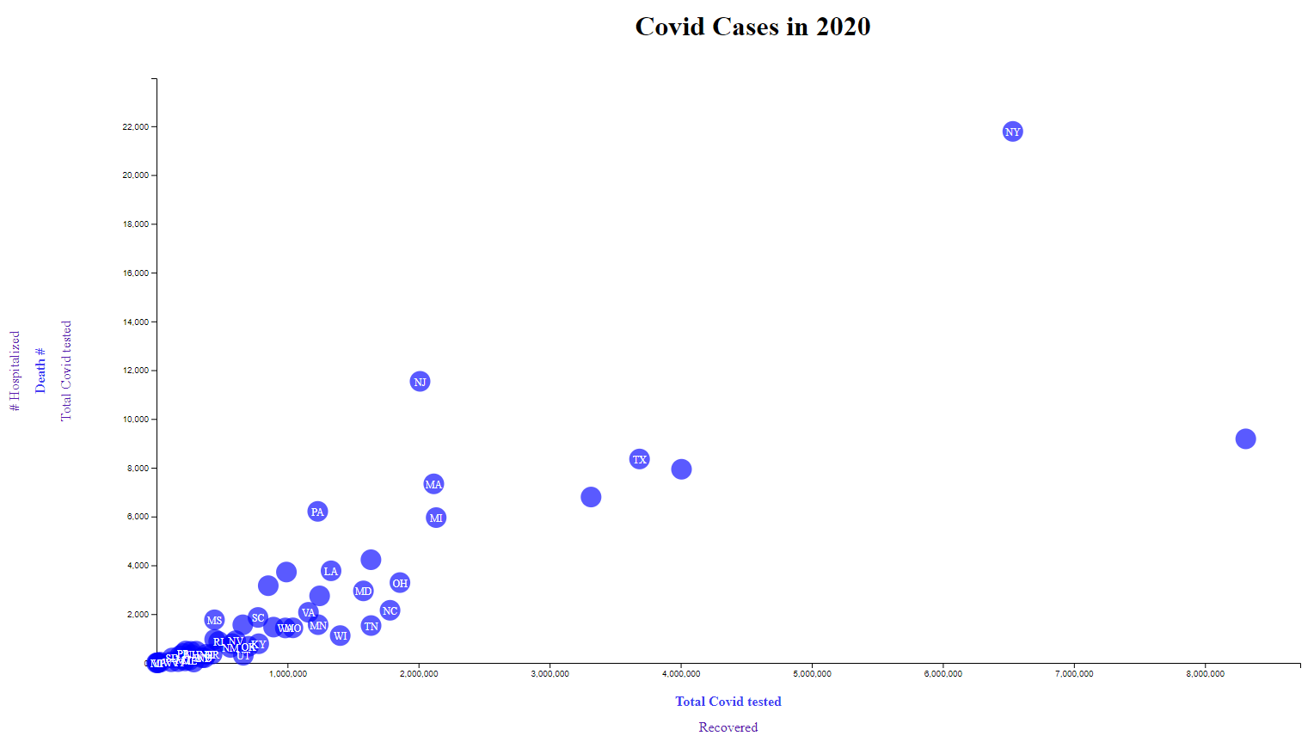
Death cases in United States
Top 5 states:
- NY
- CA
- NJ
- TX
- FL

Slide 6
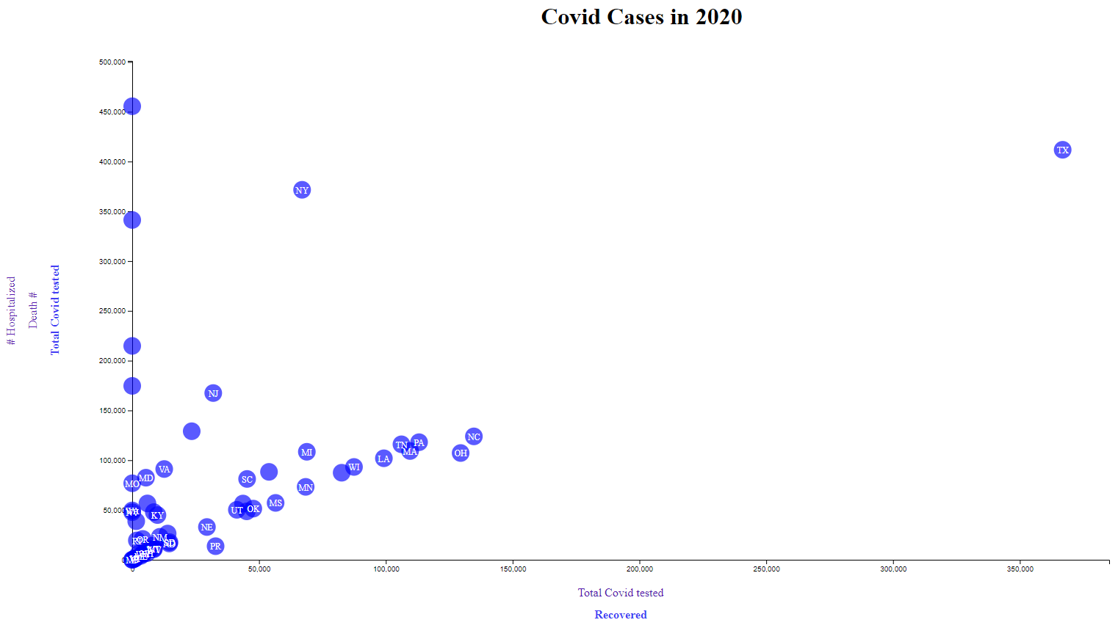
Recovered cases in United States
- TX
- NC
- PA
- TN
- OH

Slide 7
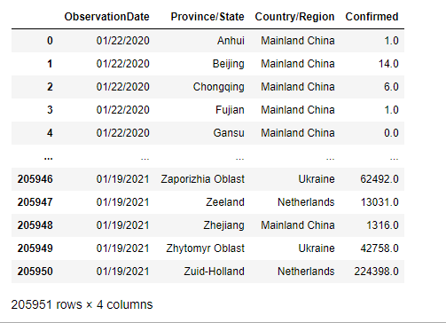
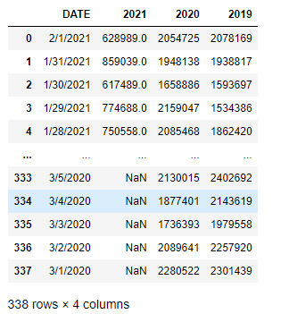
DATA
1. https://github.com/ActiveConclusion/COVID19_AirTraffic/blob/master/Air%20Traffic.ipynb
2. https://ourworldindata.org/coronavirus-source-data

Slide 8
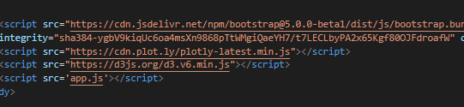
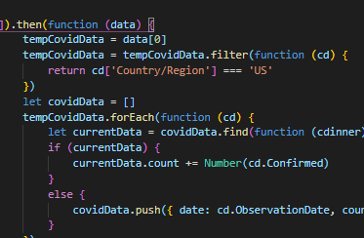

Slide 9
